Slide 1
Papers Report on Accelerating
Mechine Learning System
Reporter : Jiaqi Li
2021/04/14

Slide 2
CONTENTS
01
Introduction to Machine Learning System
04
Low-Level Loop Program Optimization
02
Model Compress/Acceleration
05
Deep Learning Compiler
03
High-Level Graph Optimization
06
Distributed System

Slide 3
Introduction to Machine Learning System
Low-Level Loop Program
The computation nodes in the dataflow graph are an abtraction of low-level operators, which are essentially loop program of tensor computation.
Computational Graph
Runtime
The frameworks like Pytorch and Tensorflow construct the dataflow graph of the model computation.
The program is compiled and return the combination of host code and device code.
Model Design
Distributed Design
Users design the high-level program of the deep learning model on Pytorch, Tensorflow.
Design the algorithm to run models on several devices at same times
Mechine Learning Optimization

Slide 4
Model Compression
Quantization
Deep Compression: Compressing Deep Neural Networks with Pruning, Trained Quantization and Huffman Coding
HAQ: Hardware-Aware Automated Quantization with Mixed Precision
Searching for Winograd-aware Quantized Networks
VS-Quant: Per-vector Scaled Quantization for Accurate Low-Precision Neural Network Inference
Rethinking Floating Point Overheads for Mixed Precision DNN Accelerators
8-bit Approximations for Parallelism in Deep Learning
I-BERT: Integer-only BERT Quantization
Pruning
Learning both weights and connections for efficient neural network
Deep Compression: Compressing Deep Neural Networks with Pruning, Trained Quantization and Huffman Coding
Learning Structured Sparsity in Deep Neural Networks
Pruning Filters for Efficient ConvNets
To prune, or not to prune: exploring the efficacy of pruning for model compression
Learning Efficient Convolutional Networks through Network Slimming
ThiNet: A Filter Level Pruning Method for Deep Neural Network Compression
Knowledge Distilling
Apprentice-Using Knowledge Distillation Techniques To Improve Low-Precision Network Accuracy
A Gift from Knowledge Distillation:Fast Optimization, Network Minimization and Transfer Learning
FITNETS: HINTS FOR THIN DEEP NETS
AutoML
HAT: Hardware-Aware Transformers for Efficient Natural Language Processing
Efficient architecture search by network transformation
Efficient neural architecture search via parameters sharing
Learning transferable architectures for scalabel image recognition

Slide 5
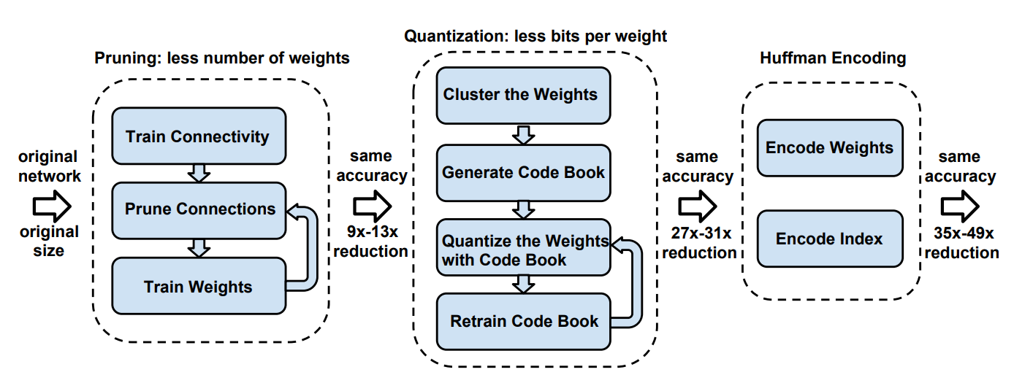
Model Compression
Deep Compression: Compressing Deep Neural Networks with Pruning, Trained Quantization and Huffman Coding
The three stage compression pipeline: pruning, quantization and Huffman coding. Pruning reduces the number of weights by 10×, while quantization further improves the compression rate: between 27× and 31×. Huffman coding gives more compression: between 35× and 49×.

Slide 6
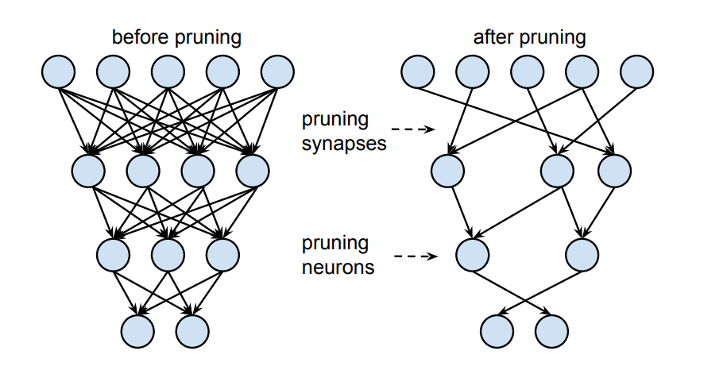
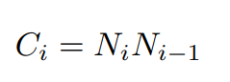
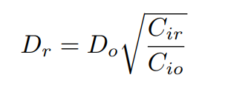
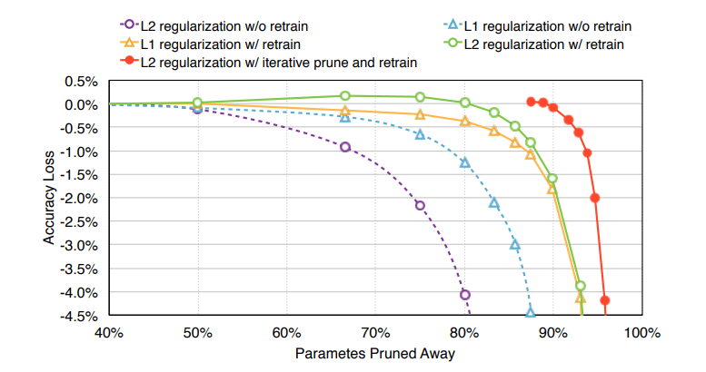
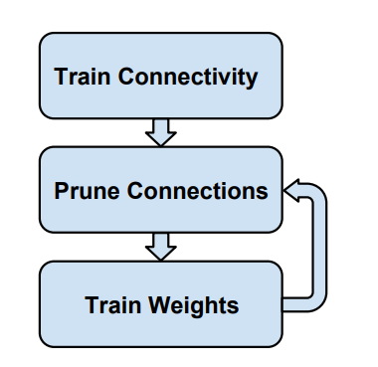
Model Compression
Deep Compression: Compressing Deep Neural Networks with Pruning, Trained Quantization and Huffman Coding
Learning both weights and connections for efficient neural networks
Stage 1 : Network Pruning
Regularization : L2
Dropout Rate :
Threhold : α*weight.std
repeat
Weight Storage : Index to Non-Zero Value

Slide 7
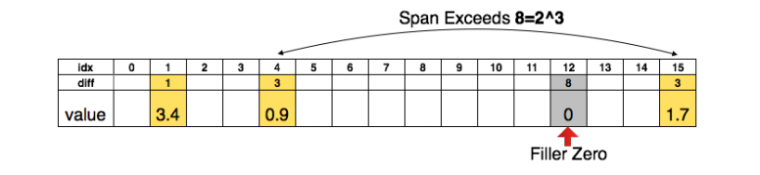
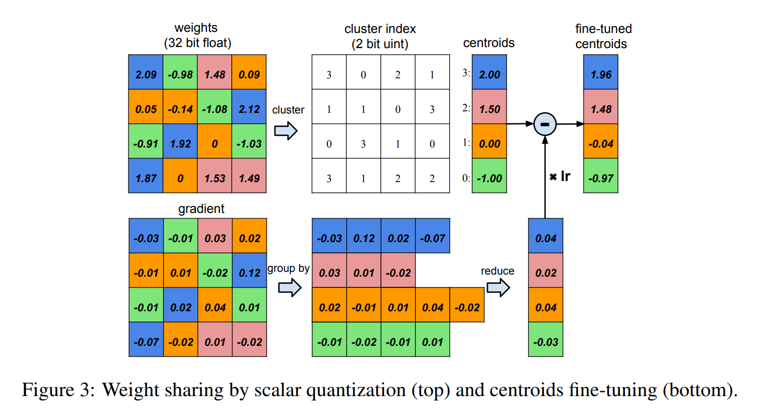
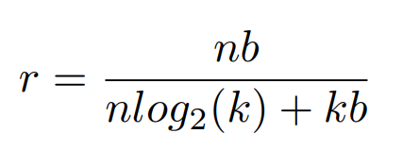
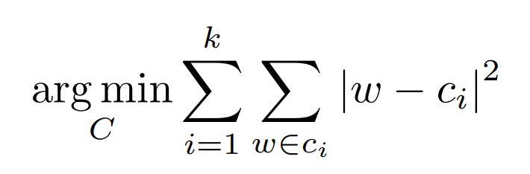
Model Compression
Deep Compression: Compressing Deep Neural Networks with Pruning, Trained Quantization and Huffman Coding
Stage 2 : Weight Sharing and Quantization
For pruned AlexNet, we are able to quantize to 8-bits (256 shared weights) for each CONV layers, and 5-bits (32 shared weights) for each FC layer without any loss of accuracy.
Compression Rate:
How to identify the shared weight clusters?
K-means

Slide 8
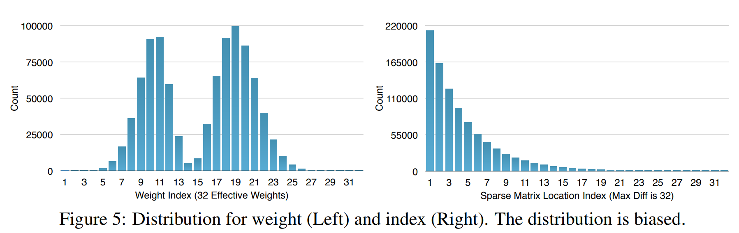
Model Compression
Deep Compression: Compressing Deep Neural Networks with Pruning, Trained Quantization and Huffman Coding
Stage 2 : Huffman Coding

Slide 9
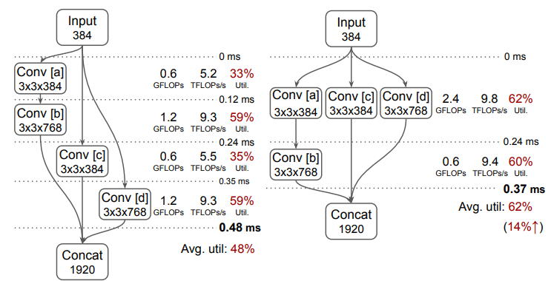
High-Level Graph Optimization
Graph-level optimizations treat an operator in the computational graph as a basic unit and perform optimization at graph level without changing the internal implementations of operators.
Data Layout Transformation
Optimizing cnn model inference on cpus
Taso: optimizing deep learning computation with automatic generation of graph substitutions
Data Movement Is All You Need: A Case Study on Optimizing Transformers
Operator Fusion
Tvm: an automated end-to-end optimizing compiler for deep learning.
Nvidia tensorrt: programmable inference accelerato
Fusionstitching: boosting memory intensive computations for deep learning workload
Data Movement Is All You Need: A Case Study on Optimizing Transformers
Automatic Substitude Graph Generation
Taso: optimizing deep learning computation with automatic generation of graph substitutions
Equality Saturation for Tensor Graph Superoptimization
IOS: INTER-OPERATORS CHEDULER FOR CNN ACCELERATION
Optimization Based on Dynamic Graph
Nimble: Efficiently Compiling Dynamic Neural Networks for Model Inference
Deep learning with dynamic computation graphs
Constant Folding
……

Slide 10
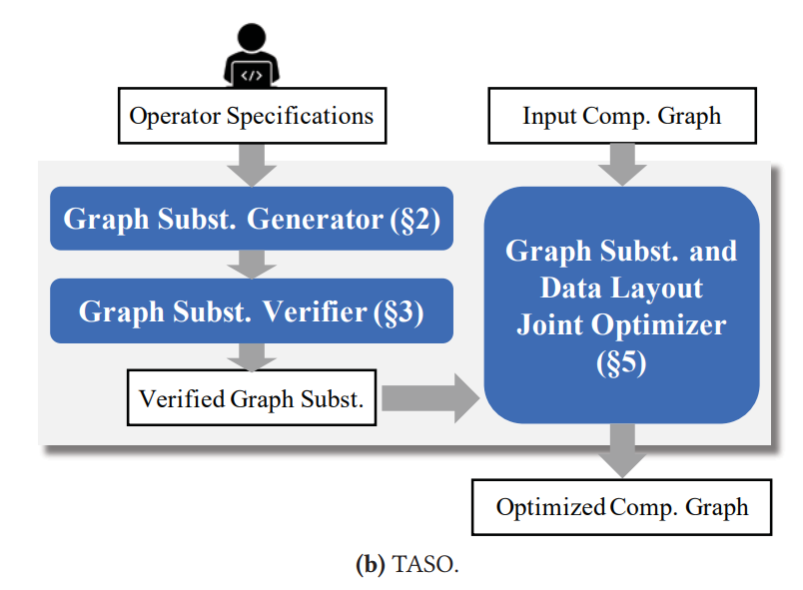
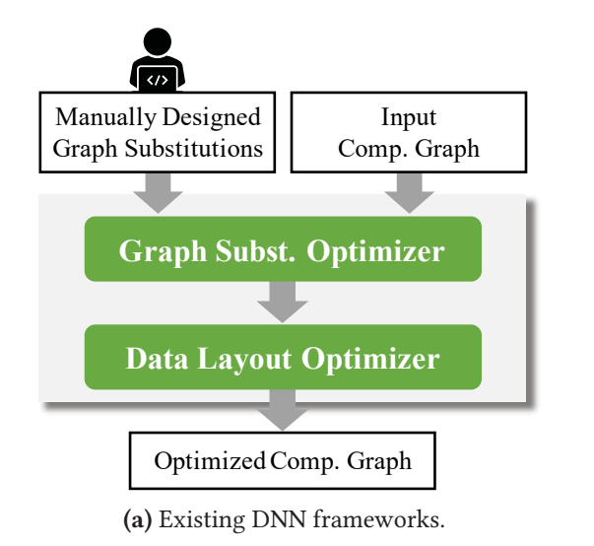
High-Level Graph Optimization
Taso: optimizing deep learning computation with automatic generation of graph substitutions
Introduction
Drawbacks :
Maintainability
Data layout
Correctness
Suboptimal
Optimizations :
Generating substitutions
Joint optimization
Formal verification
Evaluation

Slide 11
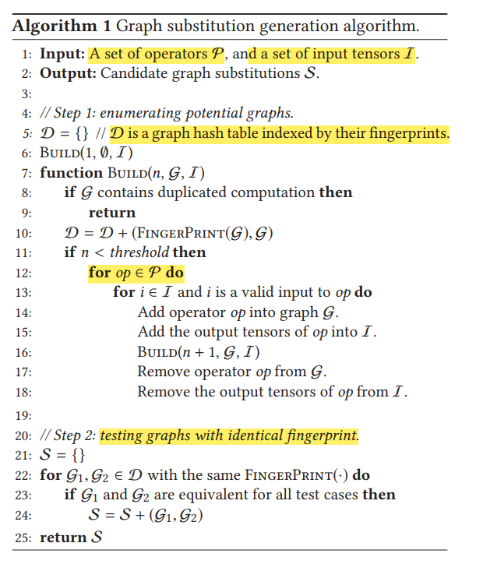
High-Level Graph Optimization
Taso: optimizing deep learning computation with automatic generation of graph substitutions
Graph Subtitution Generator
Step 1: Enumerating potential graphs and collecting their fingerprints
Step 2: Testing graphs with identical fingerprint

Slide 12
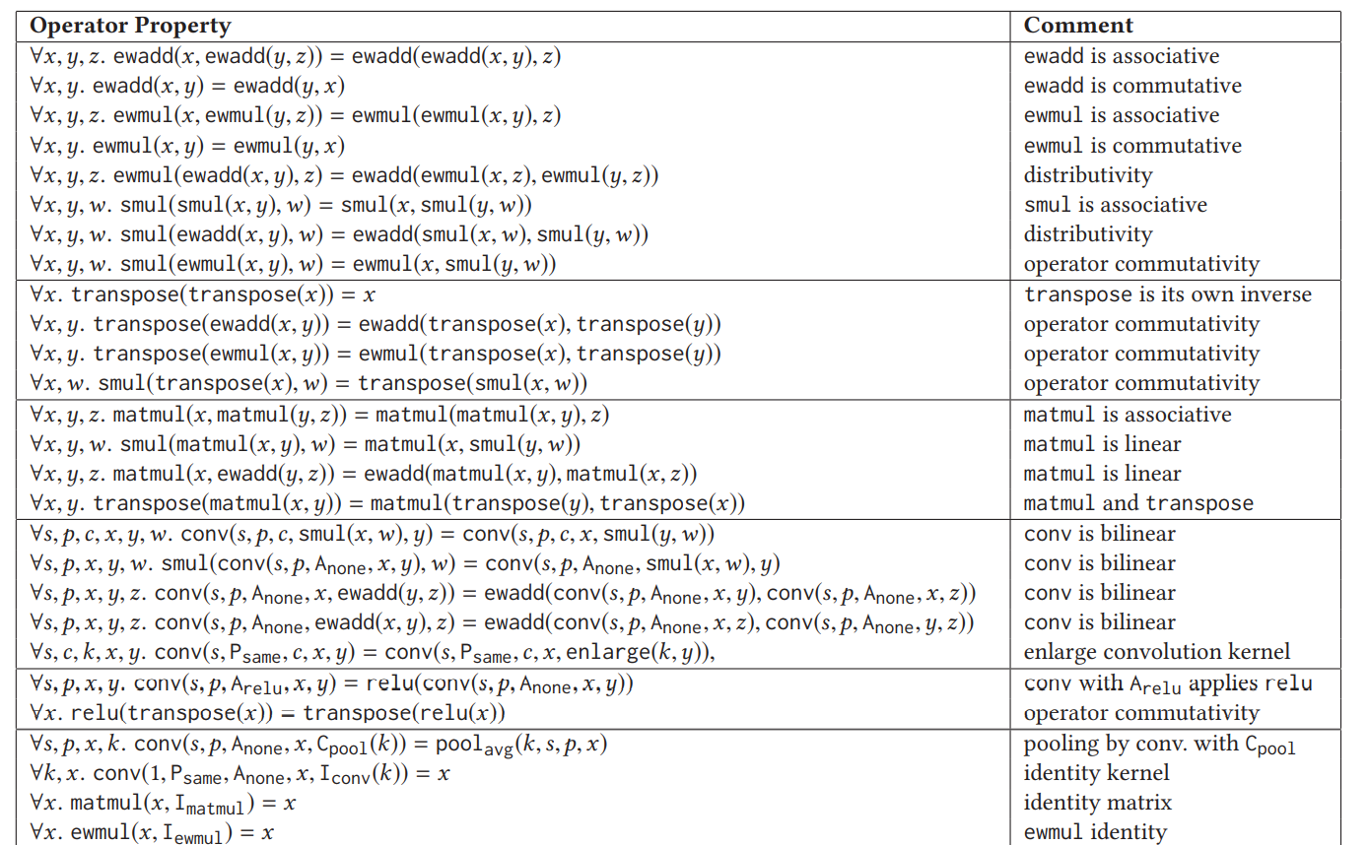
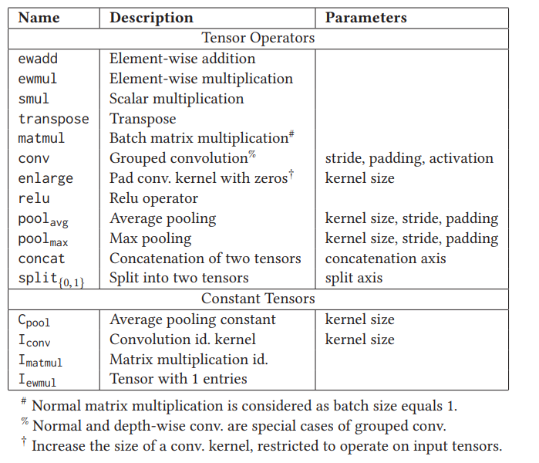
High-Level Graph Optimization
Taso: optimizing deep learning computation with automatic generation of graph substitutions
Graph Subtitution Verifier

Slide 13
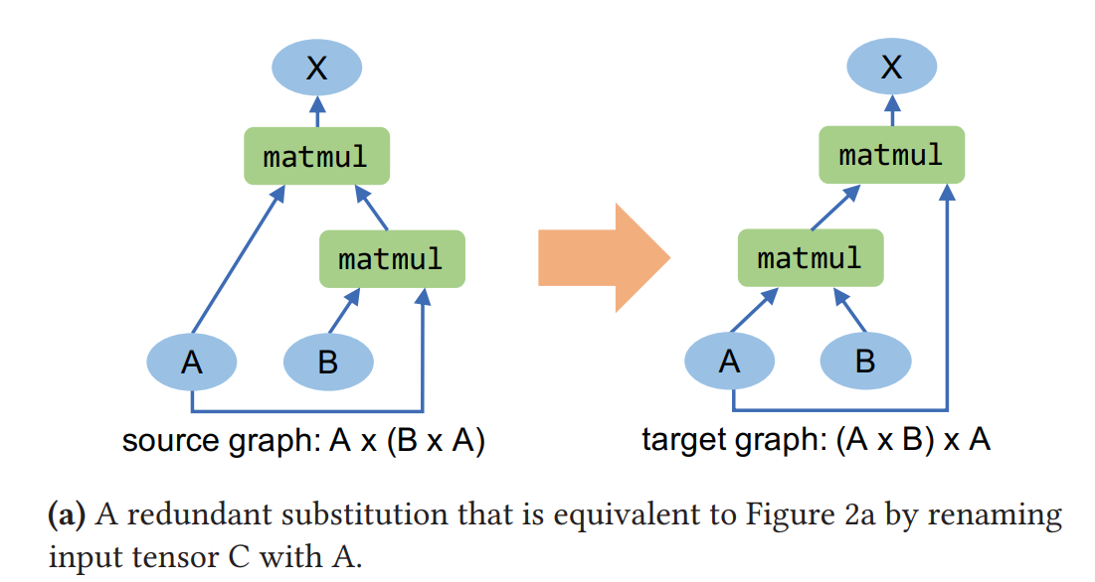
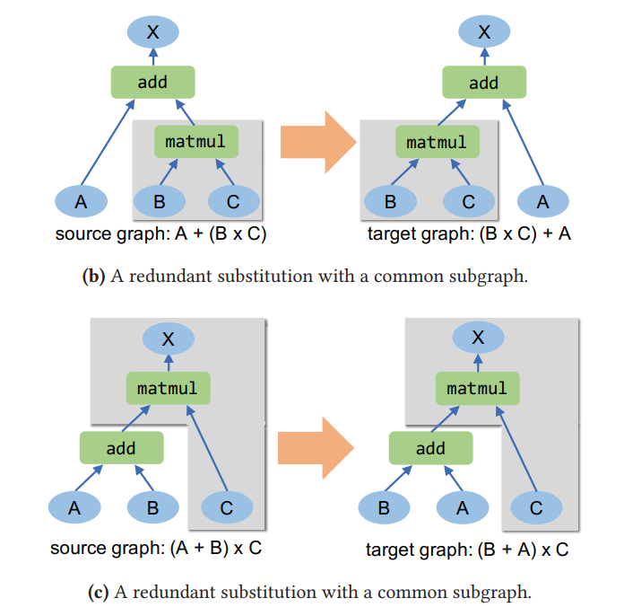
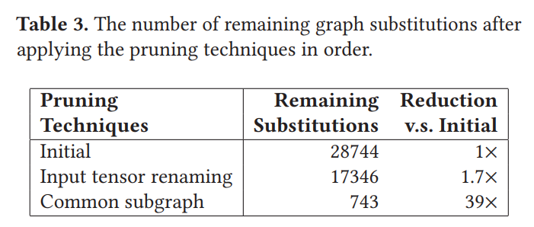
High-Level Graph Optimization
Taso: optimizing deep learning computation with automatic generation of graph substitutions
Pruning Redundant Substitutions

Slide 14
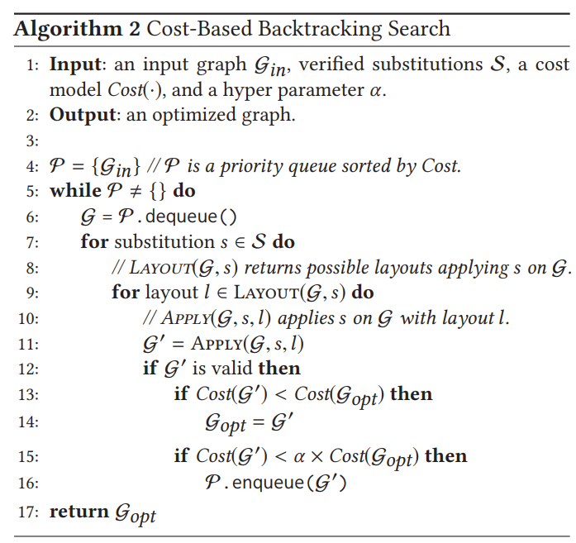
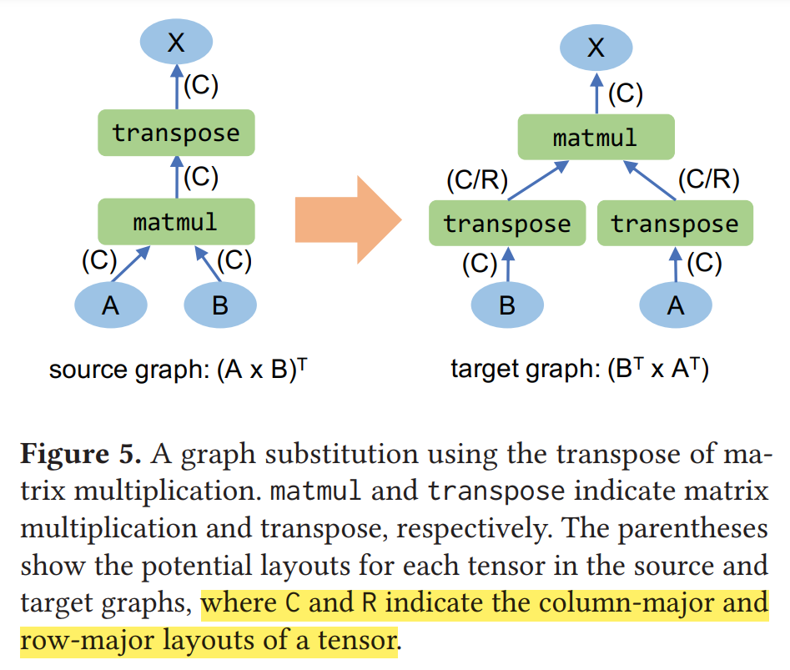
High-Level Graph Optimization
Taso: optimizing deep learning computation with automatic generation of graph substitutions
Joint Optimizer

Slide 15
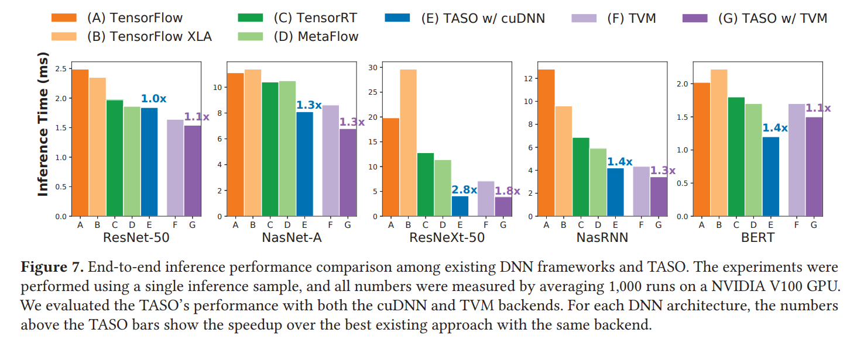
High-Level Graph Optimization
Taso: optimizing deep learning computation with automatic generation of graph substitutions
Evaluation

Slide 16
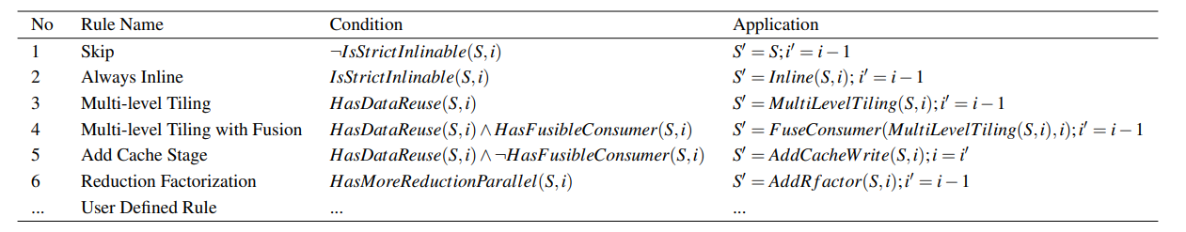
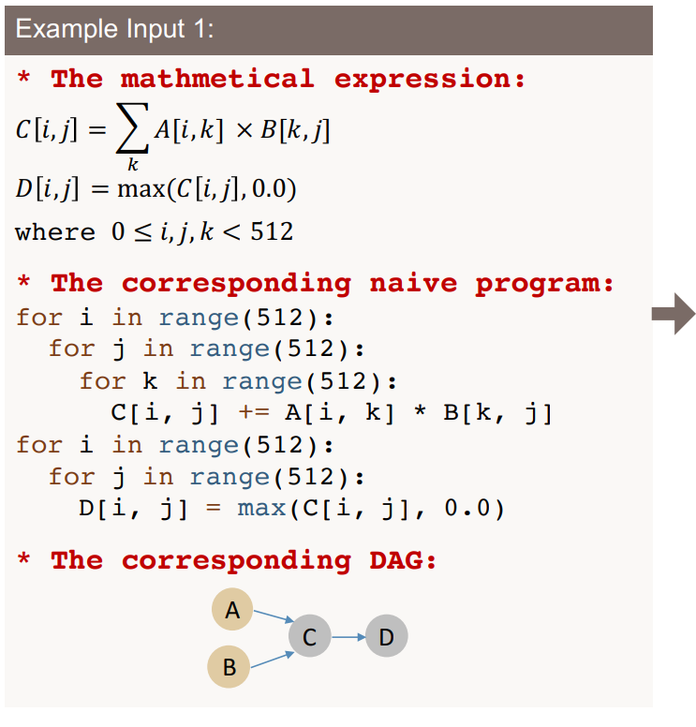
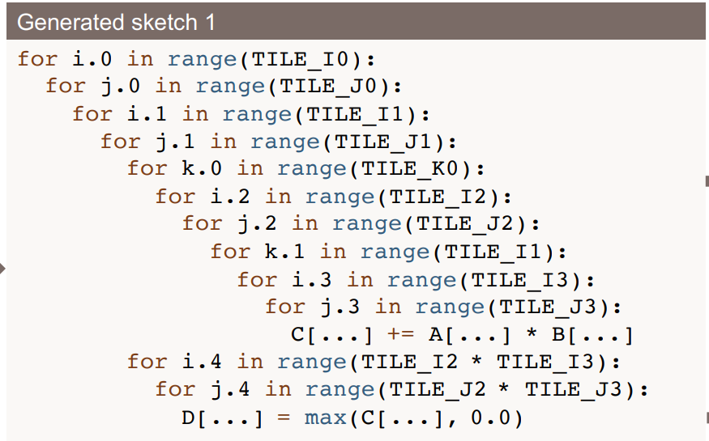
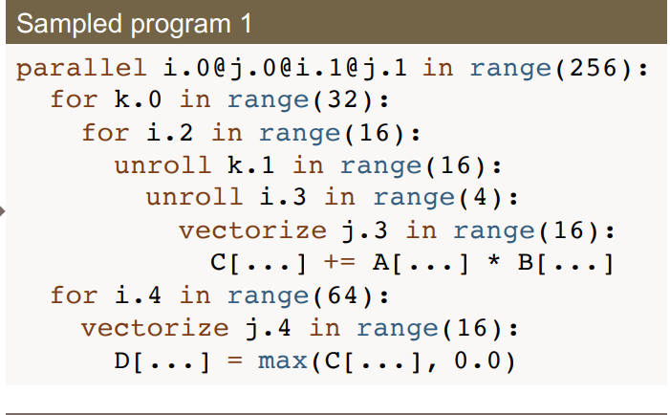
Low-Level Loop Program Optimization
Low-level optimizations process and map the operators in the graph, which are generally loop programs in deep learning networks.
Vendor-Provided Kernel Libraries
cuDNN
cuBlas
MKL-DNN
Search-Based Compilation and Automated Generation of Tensor Program (Template)
Tvm: an automated end-to-end optimizing compiler for deep learning.
Learning to optimize halide with tree search and random programs
Tensor comprehensions: framework-agnostic high-performance machine learning abstractions
Flextensor: an automatic schedule exploration and optimization framework for tensor computation on heterogeneous system
Ansor: Generating High-Performance Tensor Programs for Deep Learning
Value Function Based Performance Optimization of Deep Learning Workloads
Opentuner: an extensible framework for program autotuning
Autophase: compiler phase-ordering for hls with deep reinforcement learning
Polyhedral Compilation
A practical automatic polyhedral parallelizer and locality optimizer.
Polyhedral parallel code generation for cuda.
……

Slide 17
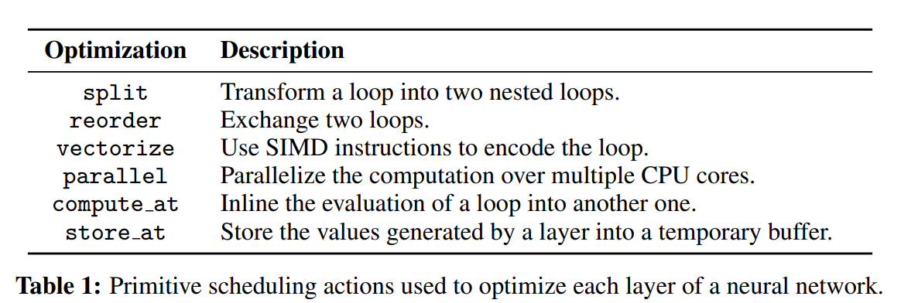
Low-Level Loop Program Optimization
Value Function Based Performance Optimization of Deep Learning Workloads
Background
TF & Pytorch ：develop and maintain a set of operator by human expertises
Halide & TVM : represent tensor computations using a declarative domain specific language based on Einstein’s notation. This approach abstracts away key implementation choices such as loop ordering, blocking, vectorization, unrolling, inlining, or parallelization, and leaves it up to the compiler to figure out which solution
How to Schedule?

Slide 18
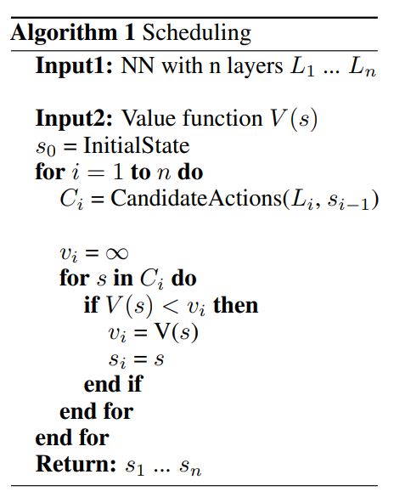
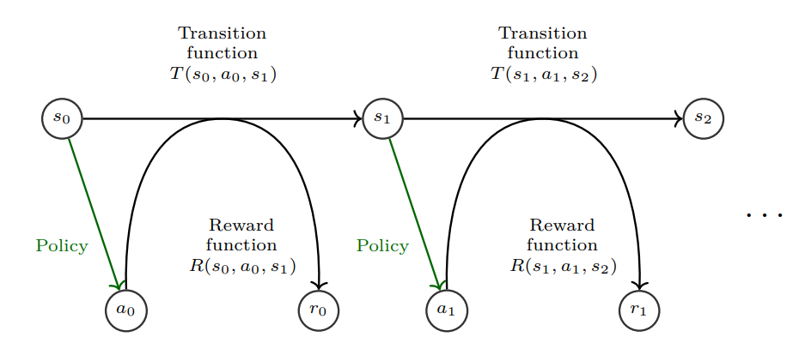
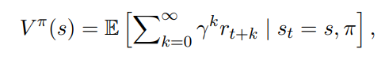
Low-Level Loop Program Optimization
Value Function Based Performance Optimization of Deep Learning Workloads
Automated Scheduling
Problem : choosing the best schedule amongst all the possible options
Method : Deterministic Markov Decision Process (MDP)

Slide 19
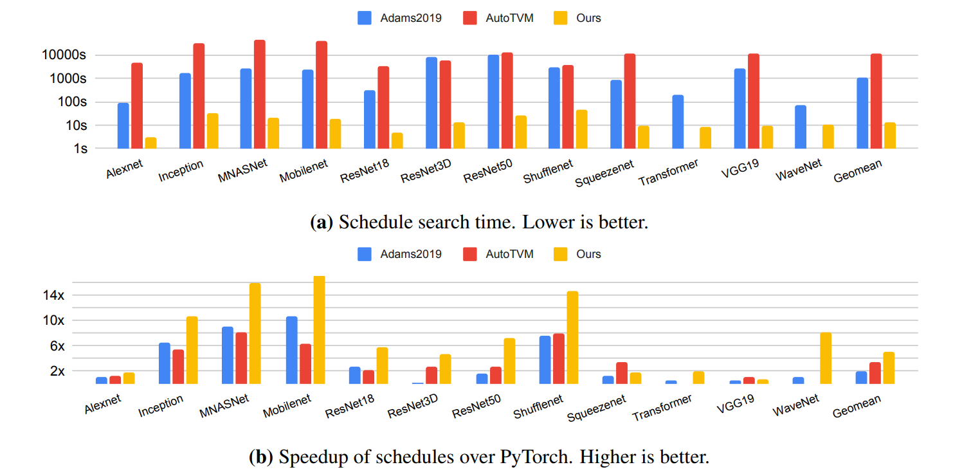
Low-Level Loop Program Optimization
Value Function Based Performance Optimization of Deep Learning Workloads
Evaluation

Slide 20
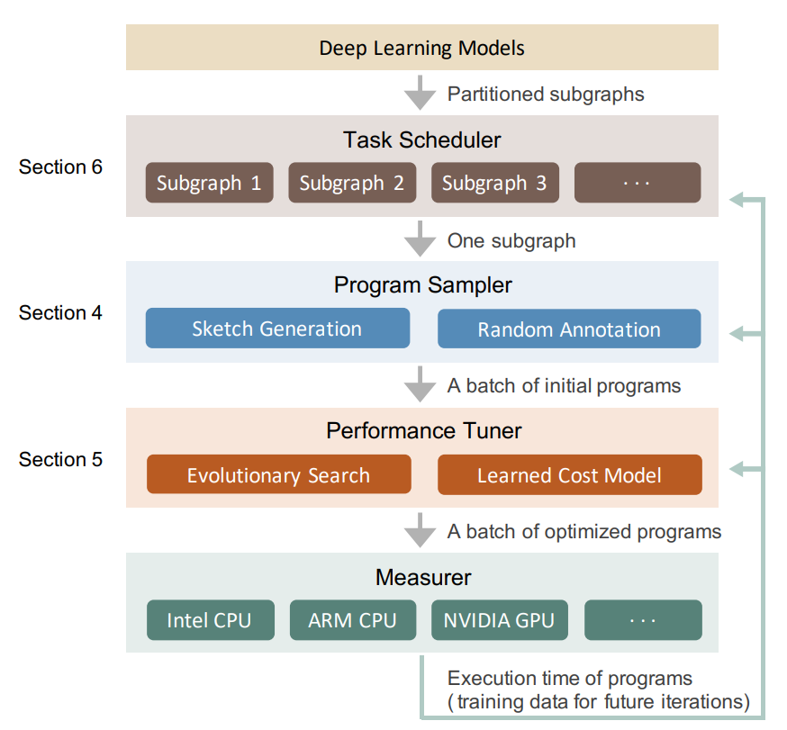
Deep Learning Compiler
Deep learning compilers differ from traditional deep learning frameworks by separating execution into a compilation, and runtime phase. During the compilation phase, we can employ more optimization to accelerate the deep learning model.
Deep Learning Compiler
Tvm: an automated end-to-end optimizing compiler for deep learning
Tensor comprehensions: framework-agnostic high-performance machine learning abstractions
Ansor: Generating High-Performance Tensor Programs for Deep Learning
Autophase: compiler phase-ordering for hls with deep reinforcement learning
Xla - tensorflow, compiled
Glow: Graph lowering compiler techniques for neural networks
Mlir: A compiler infrastructure for the end of moore’s law
WILLUMP: A Statistically-Aware End-To-End Optimizer ForMachine Learning Inference

Slide 21
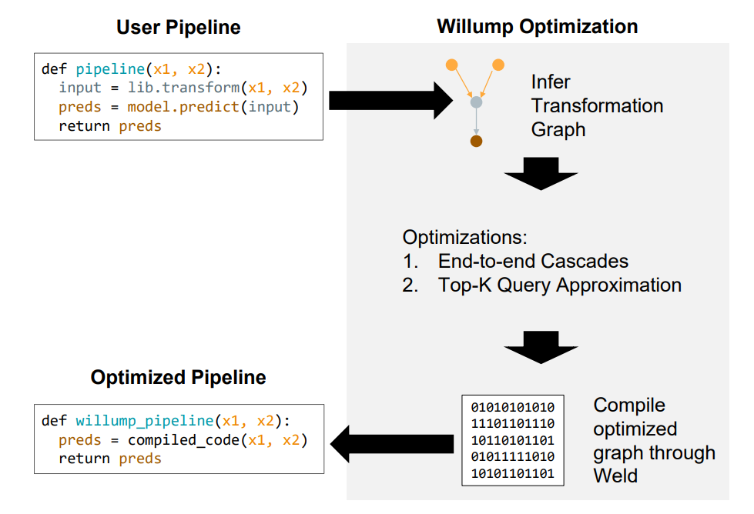
Deep Learning Compiler
WILLUMP: A Statistically-Aware End-To-End Optimizer ForMachine Learning Inference
Introduction
Insight :
ML models can often be approximated efficiently for many inputs
ML models are often used for higher-level queries, such as top-K queries
WILLUMP Optimizations :
Automatic End-to-end Cascades
Top-K Query Approximation
Stages of WILLUMP:
Graph Construction
Optimization
Compilation

Slide 22
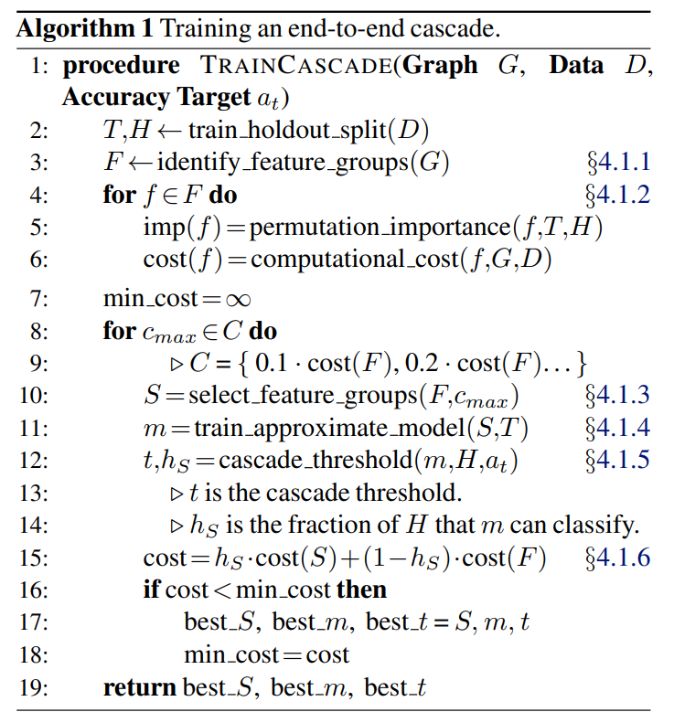
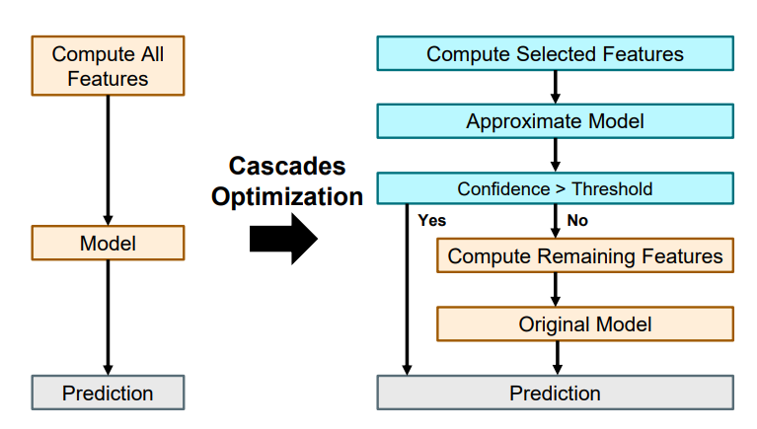
Deep Learning Compiler
WILLUMP: A Statistically-Aware End-To-End Optimizer ForMachine Learning Inference
End-to-end Cascades
perform classification by classifying some data inputs with an approximate model dependent on a subset of the original model’s input features

Slide 23
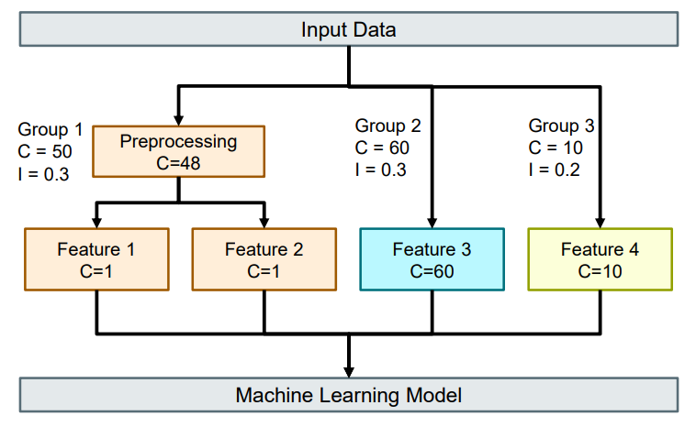
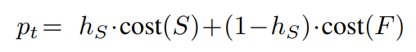
Deep Learning Compiler
WILLUMP: A Statistically-Aware End-To-End Optimizer ForMachine Learning Inference
End-to-end Cascades (Partition Features and Selection)
WILLUMP first identifies the transformation graph node that computed each feature
It then traces those nodes’ ancestors to identify their dependencies
select the features that minimize the expected prediction time :

Slide 24
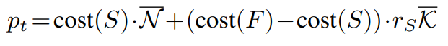
Deep Learning Compiler
WILLUMP: A Statistically-Aware End-To-End Optimizer ForMachine Learning Inference
TopK Queries Optimization
Top-K queries are fundamentally asymmetric: they must score high-scoring elements with more precision than low-scoring elements.
filter out low-scoring candidates with an approximate model
rank the remainder with the original model

Slide 25
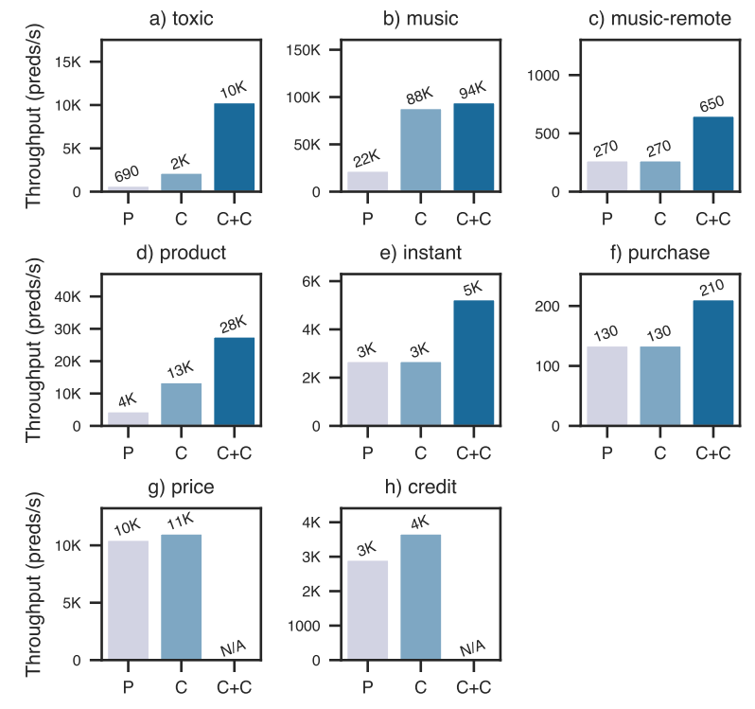
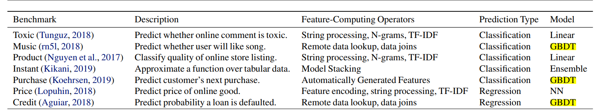
Deep Learning Compiler
WILLUMP: A Statistically-Aware End-To-End Optimizer ForMachine Learning Inference
Evaluation

Slide 26
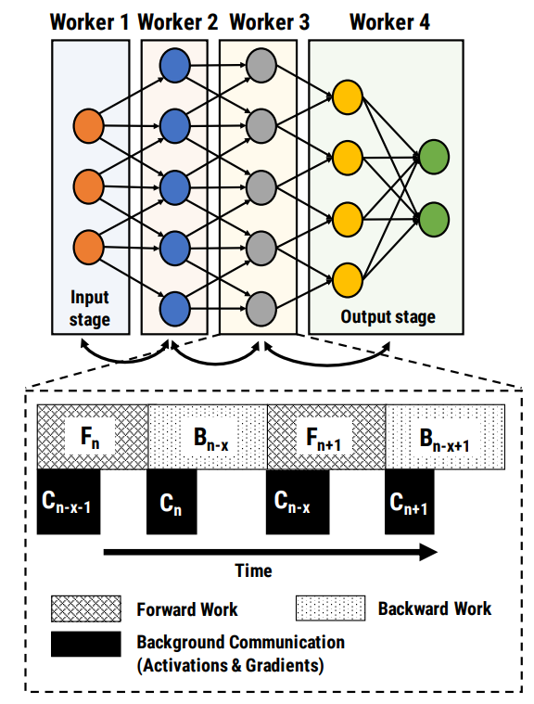
Distributed System
Training of deep learning models can be significantly accelerated with distributed computing on GPUs
Communication
A Generic Communication Scheduler for Distributed DNN Training Acceleration
Deep Gradient Compression : Reducing the Communication Bandwidth for Distributed Training
Task Schedule
Ray: A Distributed Framework for Emerging AI Applications
KungFu: Making Training in Distributed Machine Learning Adaptive
A Unified Architecture for Accelerating Distributed DNN Training in Heterogeneous GPU/CPU Clusters
AntMan: Dynamic Scaling on GPU Clusters for Deep Learning
Heterogeneity-Aware Cluster Scheduling Policies for Deep Learning Workloads
HiveD: Sharing a GPU Cluster for Deep Learning with Guarantees
Serving DNNs like Clockwork: Performance Predictability from the Bottom Up
Pipeline
PipeDream: Generalized Pipeline Parallelism for DNN Training
PipeSwitch: Fast Pipelined Context Switching for Deep Learning Applications

Slide 27
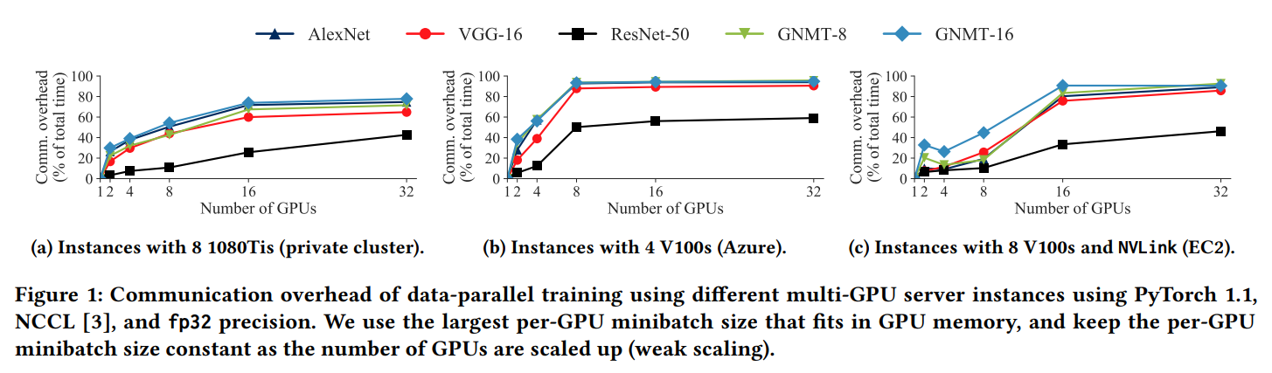
Distributed System
PipeDream: Generalized Pipeline Parallelism for DNN Training
Problem of Naïve Parallelism
communication stall caused by cross server all_reduce
to keep pipeline full, it might inject all minibatches in an epoch into the pipeline
requires each worker to wait for gradients from other workers(Wait-free Backpropagation)
Data parallelism scales well for ResNet, but bad for LSTM
Asynchronous parallel training introduces staleness and reduces statistical efficiency

Slide 28
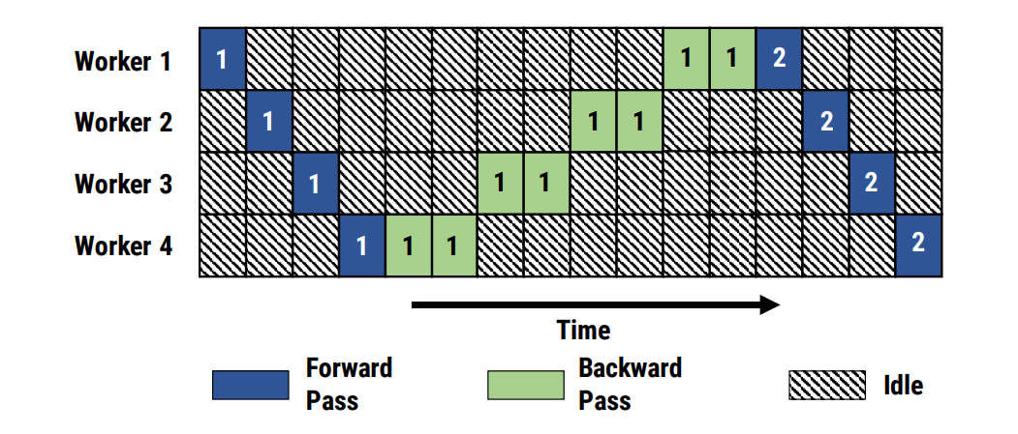
Distributed System
PipeDream: Generalized Pipeline Parallelism for DNN Training
Problem of Naïve Parallelism
Communication stall caused by cross server all_reduce
To keep pipeline full, it might inject all minibatches in an epoch into the pipeline
Requires each worker to wait for gradients from other workers(Wait-free Backpropagation)
Data parallelism scales well for ResNet, but bad for LSTM
Asynchronous parallel training introduces staleness and reduces statistical efficiency
Model parallel training results in under-utilization of compute resources
The burden of partitioning a model across multiple GPUs is left to the programmer, resulting in point solutions
These different types of models exhibit vastly different performance characteristics with different parallelization strategies
Intra-Batch Parallelism : Model Parallelism, Data Parallelism
Inter-Batch Parallelism : Pipeline

Slide 29
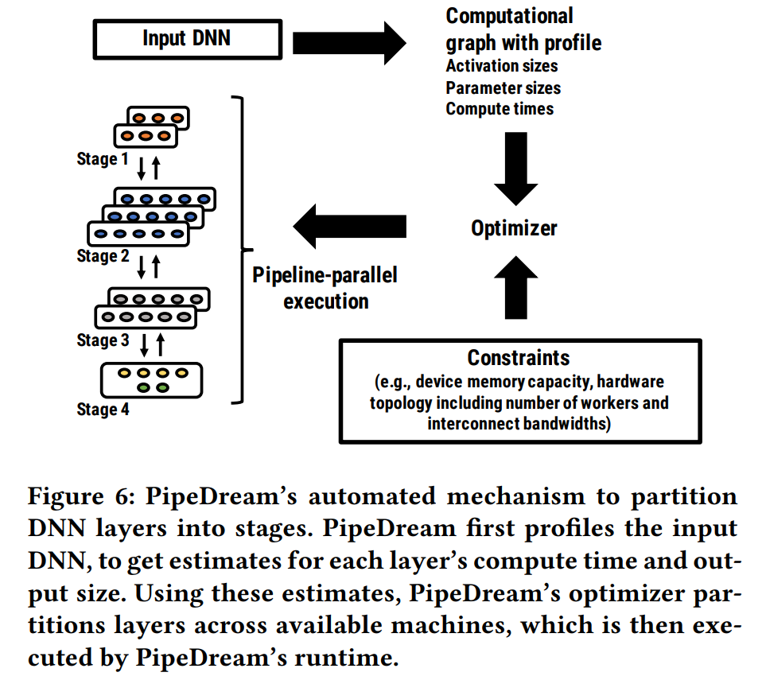
Distributed System
PipeDream: Generalized Pipeline Parallelism for DNN Training
Challenge 1 : Work Partition
Profiler :
Activation Sizes
Weight Sizes
Compute Times
Steps of Partition :
a partitioning of layers into stages
the replication factor (number of workers) for each stage
optimal number of in-flight minibatches to keep the training pipeline busy

Slide 30
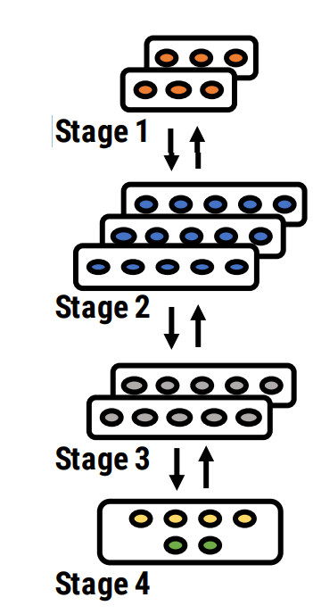
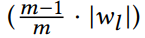
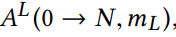
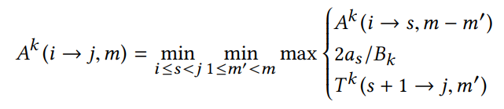
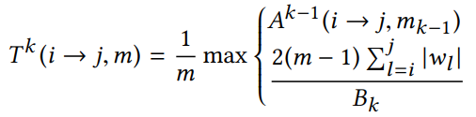
Distributed System
PipeDream: Generalized Pipeline Parallelism for DNN Training
weight communication :

Slide 31

Distributed System
PipeDream: Generalized Pipeline Parallelism for DNN Training
Challenge 2 : Work Schedule
Problems :
perform its stage’s forward pass for a minibatch, pushing the minibatch to downstream workers
perform its stage’s backward pass for a different minibatch, pushing the minibatch to upstream workers
Once in steady state, each stage alternates between performing its forward pass for a minibatch and its backward pass for an earlier minibatch (1F1B)

Slide 32

Distributed System
PipeDream: Generalized Pipeline Parallelism for DNN Training
Challenge 2 : Work Schedule
Round-Robin with Data-Parallelism :
In the first stage, all inputs with even minibatch IDs are processed by worker 1, while inputs with odd minibatch IDs are processed by worker 2. Worker 3 in the second stage processes all inputs. (1F1B-RR)

Slide 33

Distributed System
PipeDream: Generalized Pipeline Parallelism for DNN Training
Evaluation

Slide 34
THANK YOU FOR WATCHING
2021/04/07

